Slide 1
Team A001
Minimum Viable Product Design

Slide 2
High Concept
A Cooperative Arcade
Space-Boss Simulator

Slide 3
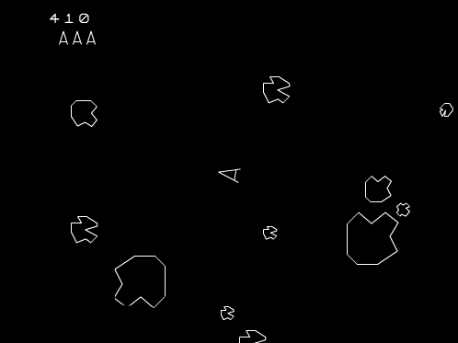
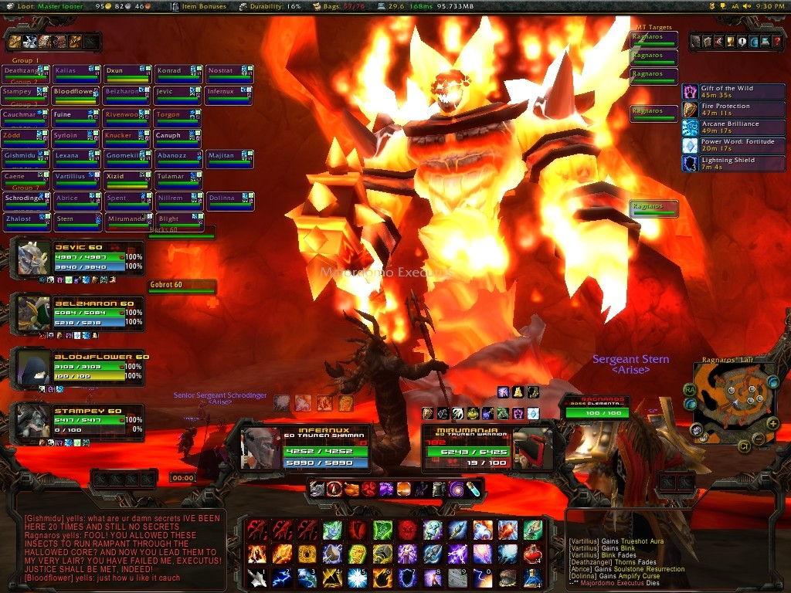
Asteroids Meets Ragnaros
X

Slide 4
Perspective Gameplay
Up to 4 players
Cooperate to take defeat a central boss
Ship classes following holy trinity
Boss periodically fires obstacles, manipulates physics, manipulates playing field (think MMO raid boss)
Player movement propulsion/velocity based
Analog Control
Each Instance is an isolated arena

Slide 5
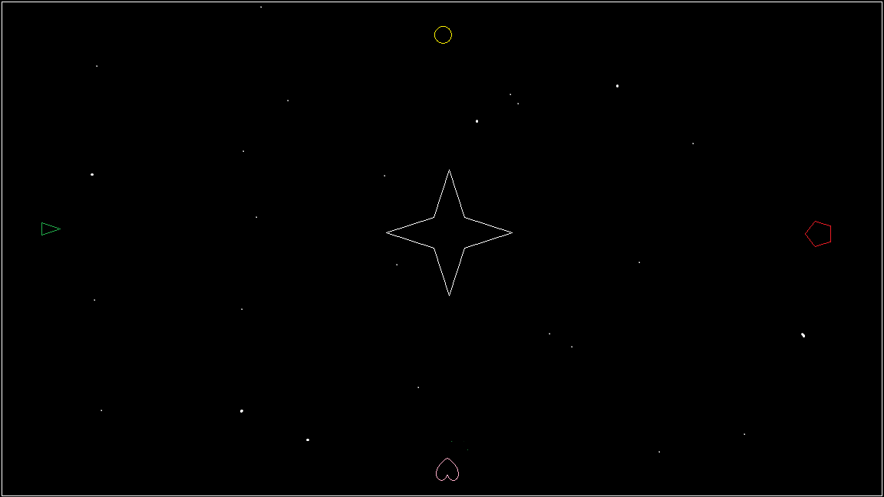
MVP

Slide 6
MVP
Playing Field allowing players to wrap to adjacent side
4 player support
1 Ship
Shoots simple projectile
Medium acceleration
Hit Points
1 Boss
1 periodic attack
Hit Points
No sound
All vector graphics of simple shapes

Slide 7
Questions?

